Slide 1
Digital Communication 24EC2208
Introduction to Information Theory

Slide 2
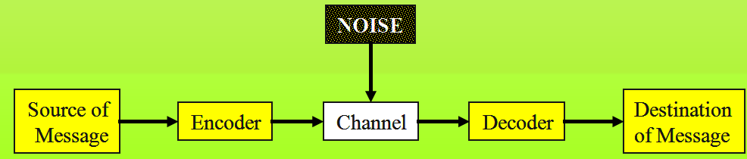
Introduction to Information Theory
Information theory is a branch of science that deals with the analysis of a communications system.
Claude Shannon Published a landmark paper in 1948 that was the beginning of the branch of information theory.
We are interested in communicating information from a source to a destination

Slide 3

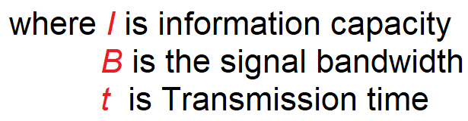
Information Theory
Information theory is a highly theoretical study of the efficient use of bandwidth to propagate information through electronic communications systems.
Information theory can be used to determine the information capacity of a data communications system.
Information capacity is a measure of how much information can be propagated through a communications system and is a function of bandwidth and transmission time.

Slide 4
Information capacity represents the number of independent symbols that can be carried through a system in a given unit of time.
The most basic digital symbol used to represent information is the binary digit, or bit.
Therefore, it is often convenient to express the information capacity of a system as a bit rate.
Bit rate is simply the number of bits transmitted during one second and is expressed in bits per second (bps).
Bit rate
$$f_{b}=2B\log_{2}{L, where L=2^{n}}$$

Slide 5
M-ary (Multi-level) Encoding
M-ary is a term derived from the word binary.
M simply represents a digit that corresponds to the number of conditions, levels, or combinations possible for a given number of binary variables.
It is often advantageous to encode at a level higher than binary where there are more than two conditions possible.
For example, a digital signal with four possible conditions (voltage levels, frequencies, phases, and so on) is an M-ary system where M = 4
If there are eight possible conditions, M = 8 and so forth.

Slide 6


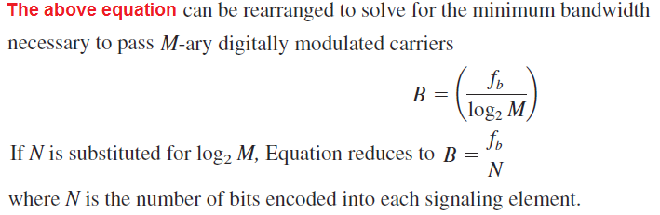
M-ary signals:
If more than two levels are used for signaling (higher-than-binary encoding), more than one bit may be transmitted at a time, and it is possible to propagate a bit rate that exceeds 2B.
Using multilevel signaling, the Nyquist formulation for channel capacity is

Slide 7
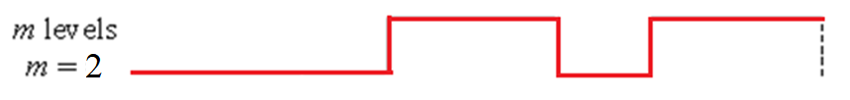
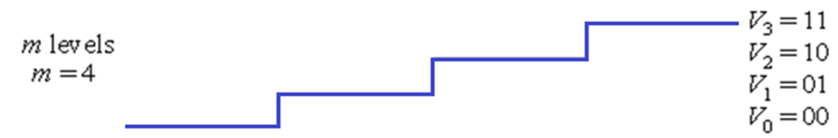
M-ary Encoding
Binary
4-ary

Slide 8
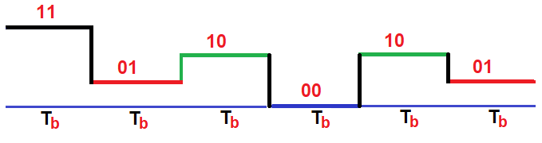

Slide 9



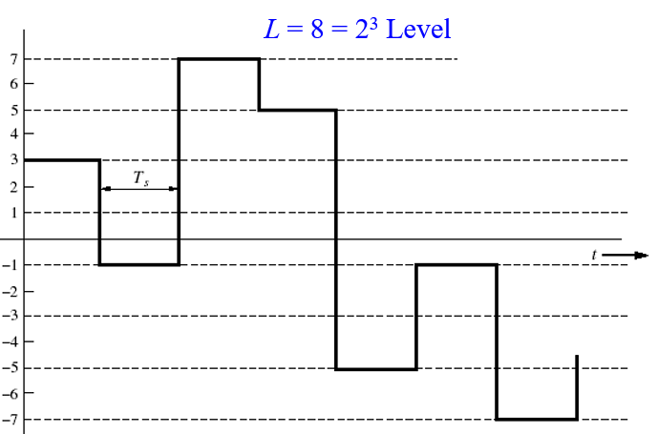
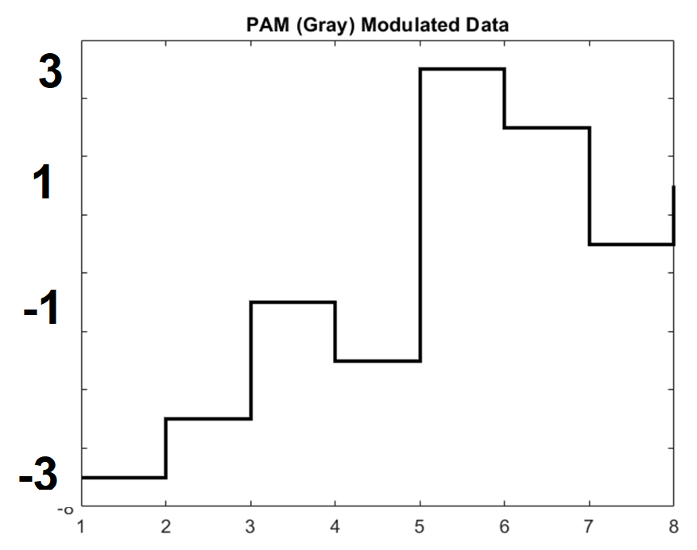
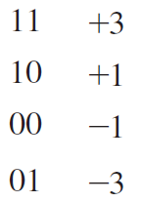
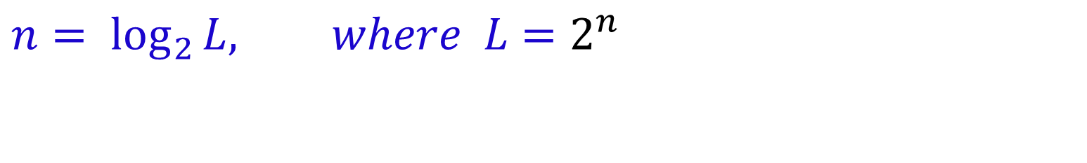
$$n=\log_{2}{L, where L=2^{n}}$$

Slide 10
There are three reasons for the emphasis of Discrete PAM:
Discrete pulse-amplitude modulation is simple to analyze.
2. It is the most efficient form of discrete pulse modulation in terms of both power and bandwidth use.
3. The analytic techniques developed for handling discrete pulse-amplitude modulation may be extended to other discrete-pulse modulation techniques using phase or frequency.

Slide 11
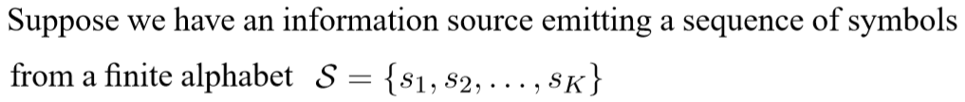
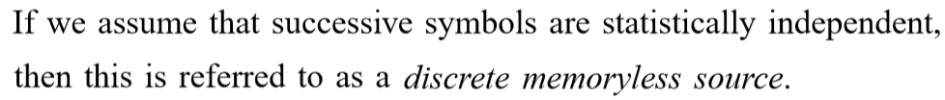
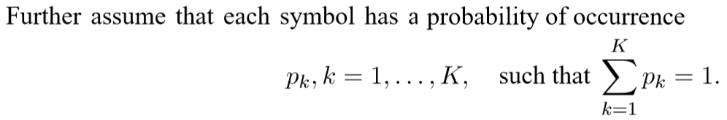
Discrete Memoryless Source
Source
s₁, s₂, …

Slide 12
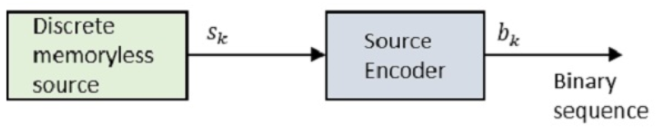
Source Coding
Efficient representation of discrete source.
Two functional requirements.
The code words produced by the encoder are in binary form.
The source code is uniquely decodable, so that the original source sequence can be reconstructed perfectly from the encoded binary sequence.

Slide 13
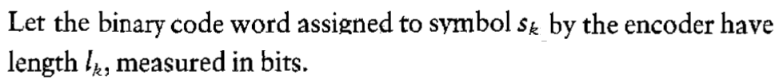
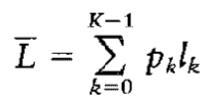
Source encoder …

Slide 14
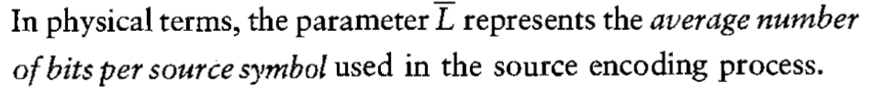
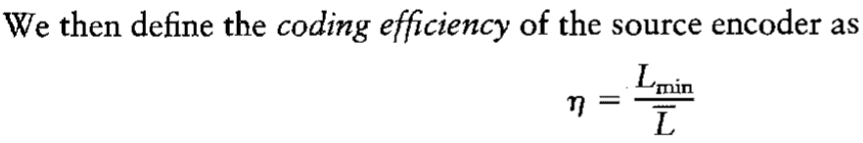
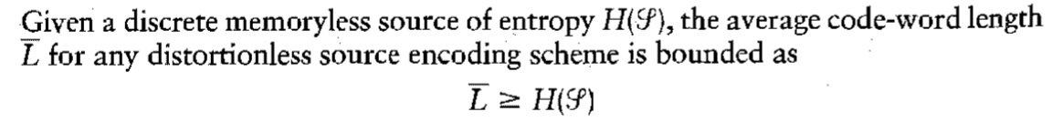
Source Encoder

Slide 15
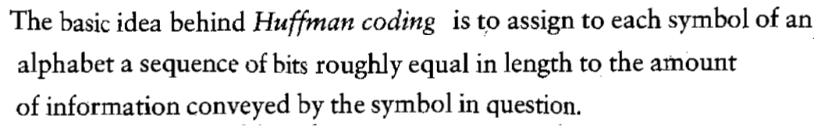
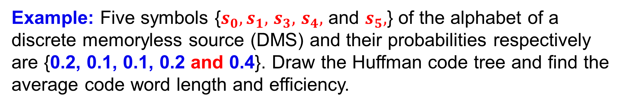
Huffman Coding
Example: Five symbols {$s_{0},s_{1},$ $s_{3},$ $s_{4},$ and $s_{5},$} of the alphabet of a discrete memoryless source (DMS) and their probabilities respectively are {0.2, 0.1, 0.1, 0.2 and 0.4}. Draw the Huffman code tree and find the average code word length and efficiency.

Slide 16
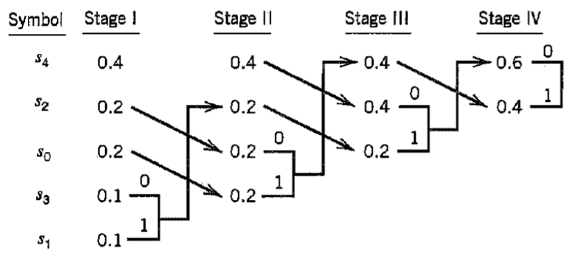
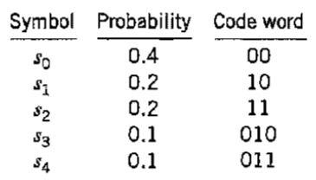
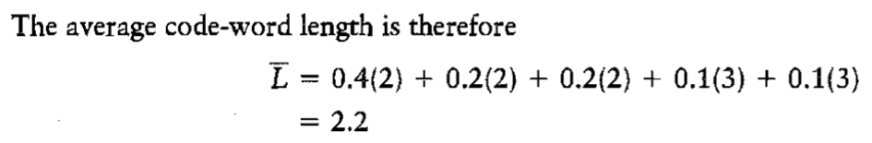

Slide 17
End

